Slide 1
KPI FINDINGS USING MYSQL

Slide 2
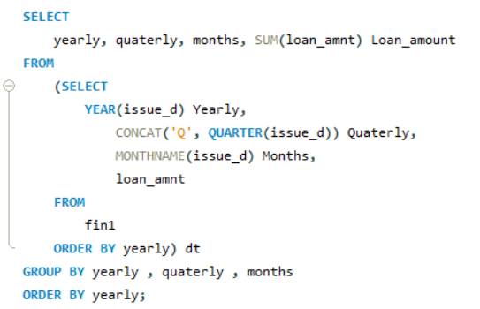
KPI-1 Year wise loan amount Stats

Slide 3
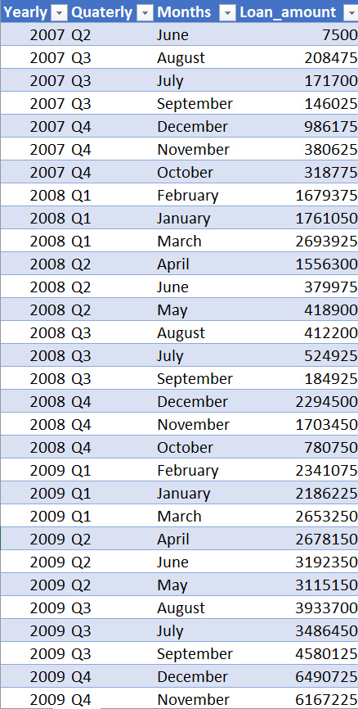
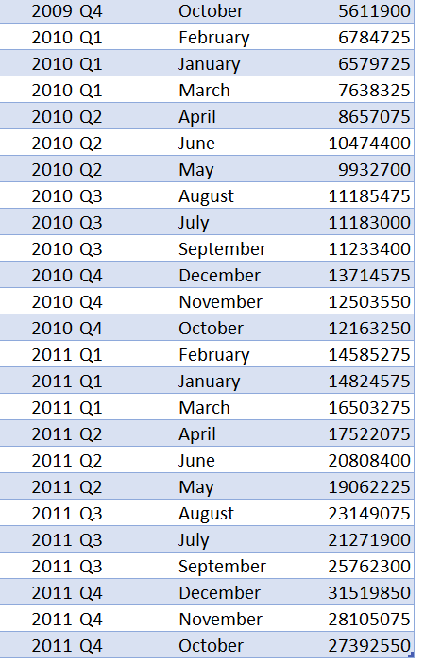
KPI-1 OUTPUT

Slide 4
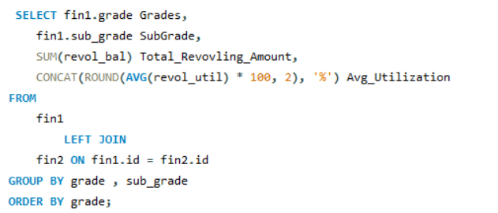
KPI-2 Grade and sub grade wise revol_bal

Slide 5
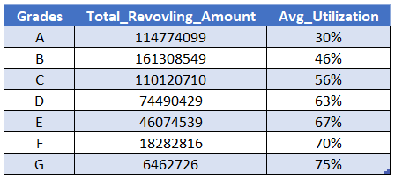
KPI-2 OUTPUT

Slide 6
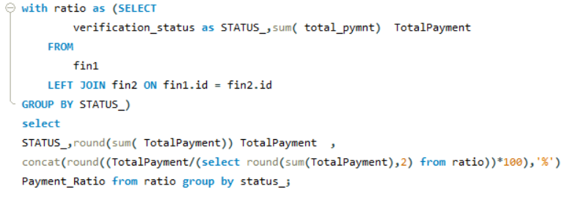
KPI- 3 Total Payment for Verified Status Vs Total Payment for Non Verified Status

Slide 7
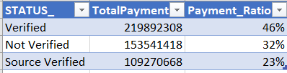
KPI- OUTPUT

Slide 8
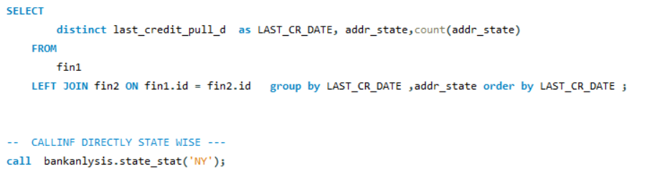
KPI-4 State wise and last_credit_pull_d wise loan status

Slide 9
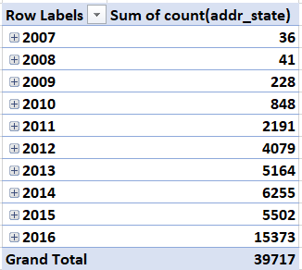
KPI-4 OUTPUT

Slide 10
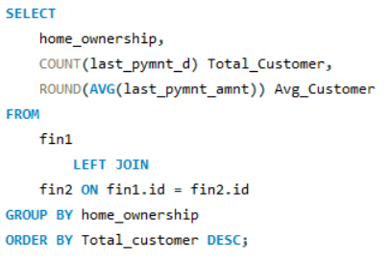
KPI-5 Home ownership Vs last payment date stats

Slide 11
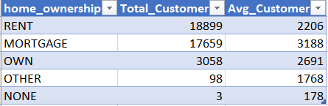
KPI-5 OUTPUT

